Slide 1










Analyzing Obesity Prevalence and its Influencing Factors Across Countries
By: Prathima Swetha Balaraju

Slide 2
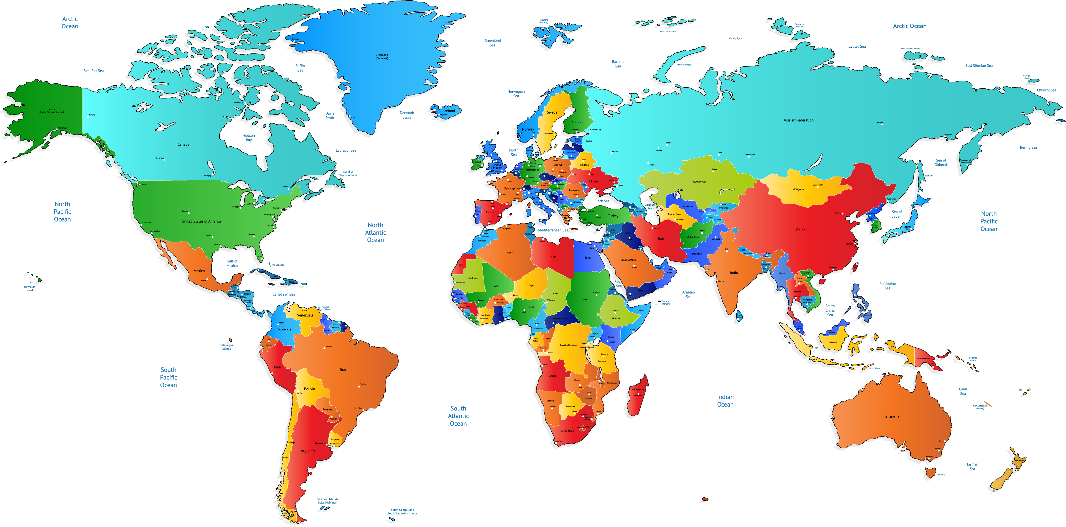
Motivation:
Obesity has become a significant public health issue worldwide, with increasing rates observed in both developed and developing countries.
This project aims to explore the factors contributing to obesity prevalence across countries over different time periods.
By analyzing key indicators such as GDP per capita, daily protein supply, daily calorie supply,life expectancy, physical activity, meat consumption, this project provides insights into how socioeconomic factors influence obesity rates.
These insights can help inform public health policies, promote healthier lifestyles, and ultimately improve public health outcomes.

Slide 3
Goals & Objectives
What is Obesity Prevalence?
To analyze the trends in obesity rates of countries over time, which have highest and lowest obesity rates, and exploring obesity prevalence distribution.
Top and bottom countries trends and how the obesity prevalence changed over time for top five countries.
Analyzing trends over decades for daily protein supply,obesity prevalence,calorie consumption,population,life expectancy.
Exploring the relationship between obesity prevalence, daily protein supply, daily calorie consumption.
Exploring the factors, such as meat consumption and average daily steps, and life expectancy correlate with obesity prevalence.

Slide 4
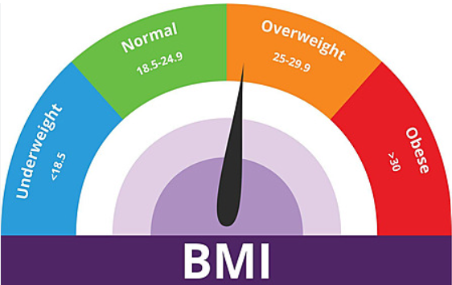

According to the WHO, the global prevalence of obesity has nearly tripled since 1975.
In 2016, approximately 13% of the world's adult population (about 650 million people) were classified as obese.
Obesity prevalence is typically defined as the proportion of a population that has a body mass index (BMI) of 30 or higher

Slide 5

DATA
QUESTIONS?

Slide 6
Which country had the greatest increase in obesity rates over time, and which had a decrease?

Slide 7
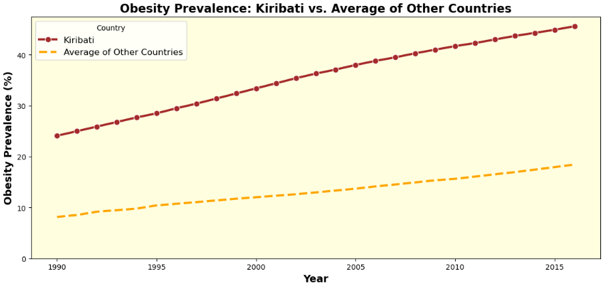
Notes:
Y axis to 0

Slide 8
Which country had lowest obesity rates in overall?

Slide 9
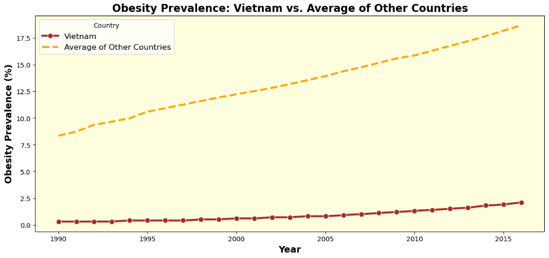
Notes:
Strt with 0, other line shows the avg for the rest of the countries in same plot

Slide 10
Was there difference in top five obesity rates from
1990-2015?
Notes:
Highlight the ones are different in plot

Slide 11
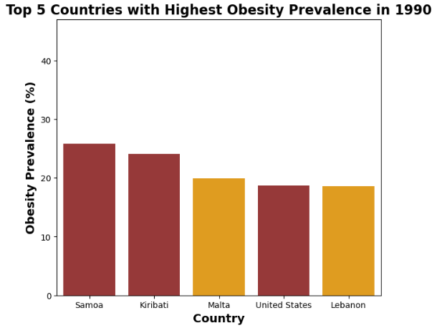
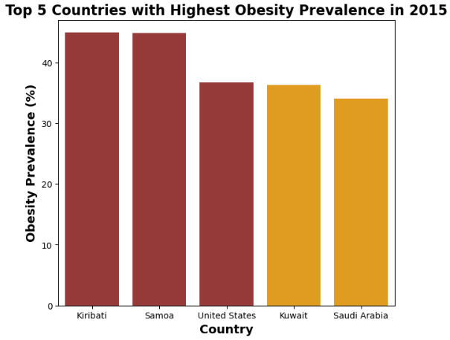

Slide 12
How does the obesity prevalence change over time in the top five countries?

Slide 13
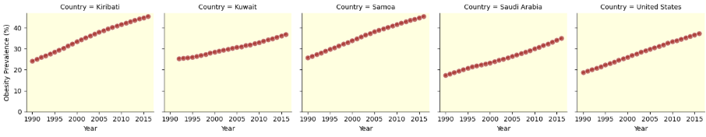

Slide 14

How Does meat consumption affect Obesity prevalence?

Slide 15
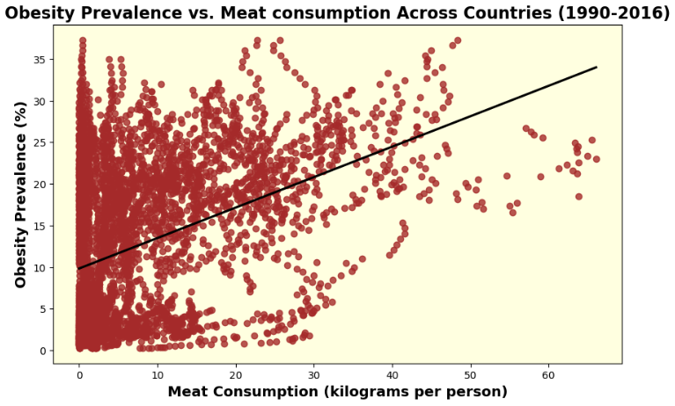
Corr = 0.42

Slide 16

How Does Average daily steps affect obesity prevalence?

Slide 17
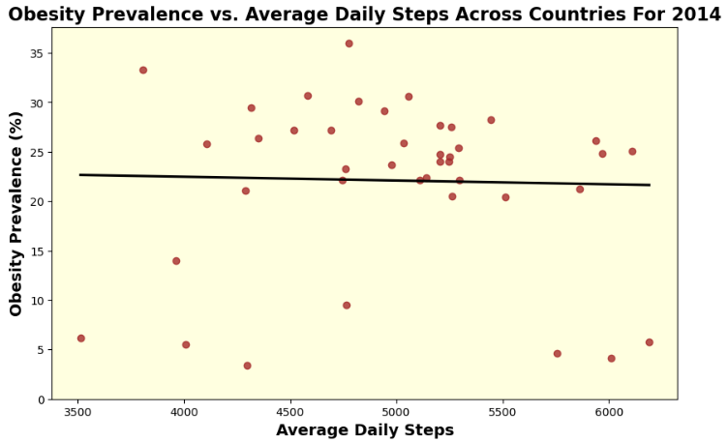
Corr = -0.029

Slide 18
Conclusion:
This analysis provides valuable insights and the distribution of Obesity prevalence varies across countries with some countries had the greatest increase in obesity rates over time.
None of the countries had a decrease in Obesity rates over time. There are countries with lowest Obesity rates overall.
The countries had higher obesity rates in 2015 than compared to 1990. Since the Obesity rates are increasing over time. Considering GDP per capita, Daily protein supply, Life expectancy, Daily calories supply, there is moderate correlation between GDP per capita and Obesity prevalence, the people in wealthier countries and more developed countries have more access to processed foods and sedentary lifestyles.
The correlation between Average steps taken and obesity prevalence is surprisingly very weak, the physical activity alone may not be a predictor of Obesity.

Slide 19
QUESTIONS?

Slide 20
Links:
https://ourworldindata.org/
https://www.kaggle.com/

Slide 21


